Slide 1
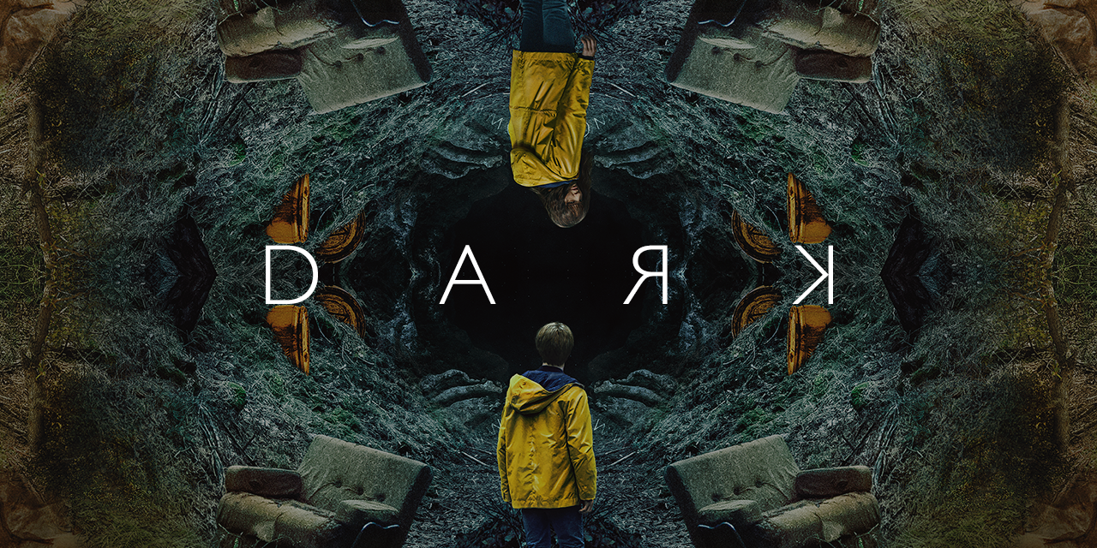
Social Network Analysis on Dark Dataset
Professor: Bei Yan
Course: BIA 658
Presented by: Group 11
Mrudul Agrawal
Shourya Chouhan
Balwant Deo
Bryan Campos

Slide 2
INDEX
Introduction
Problem Statement
Dataset understanding and preparation
Exploratory data analysis
Descriptive statistics
Analytical approach
Interpretations

Slide 3
Introduction
Has there ever been a TV show more complicated than Netflix's Dark? Sure, there have been other shows involving time travel, but nothing approaching Social Network Analysis on Dark Datasetthe complex web of relationships and timelines that is this German-language sci-fi series.
The series revolves primarily around four families living in the town of Winden, Germany: the Kahnwalds, the Nielsens, the Dopplers, and the Tiedemanns.
Thanks to a wormhole in the caves under the nuclear power plant that can transport you through time in 33-year increments, it turns out these four families are even more closely related than they knew

Slide 4
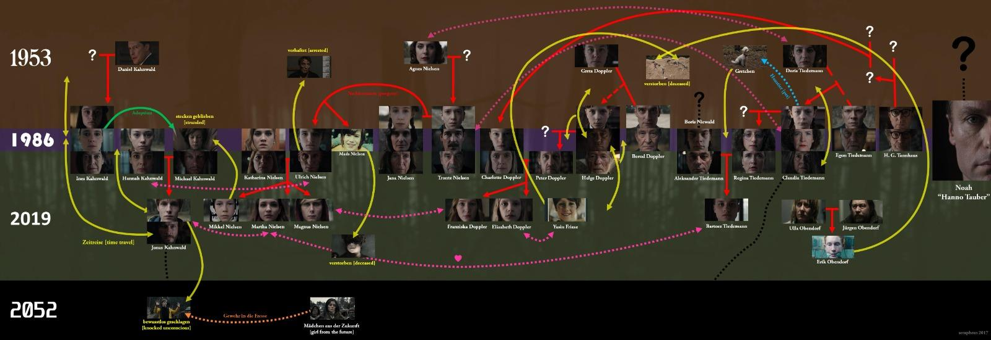
Different Timelines

Slide 5
Problem Statement
We will be analysing characters and different timelines through the data and find the outcome in respect to-
Important characters
Influential characters
Important timeline

Slide 6
Dataset understanding and preparation
This dataset contains information about the relationship between the different characters present in different timelines of the Netflix original TV show Dark.
Nodes: The dataset contains 83 nodes which are the distinct characters,years and type of relationship throughout the 3 seasons of the show
Edges:The dataset contains 215 edges which are the relationships between different characters
Key variables: Character_name
Character_years
Characters_parentOF

Slide 7
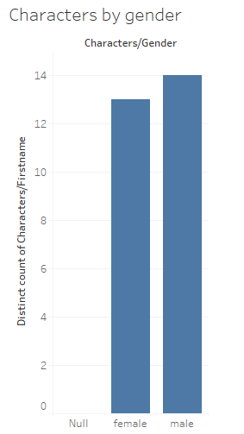
Exploratory data analysis
We used Tableau to do data analysis as we can see there are total 27 Character out of which 13 of them are female and 14 are male

Slide 8

Exploratory data analysis
Positive Sentiment Analysis on dark
What people are saying about dark

Slide 9
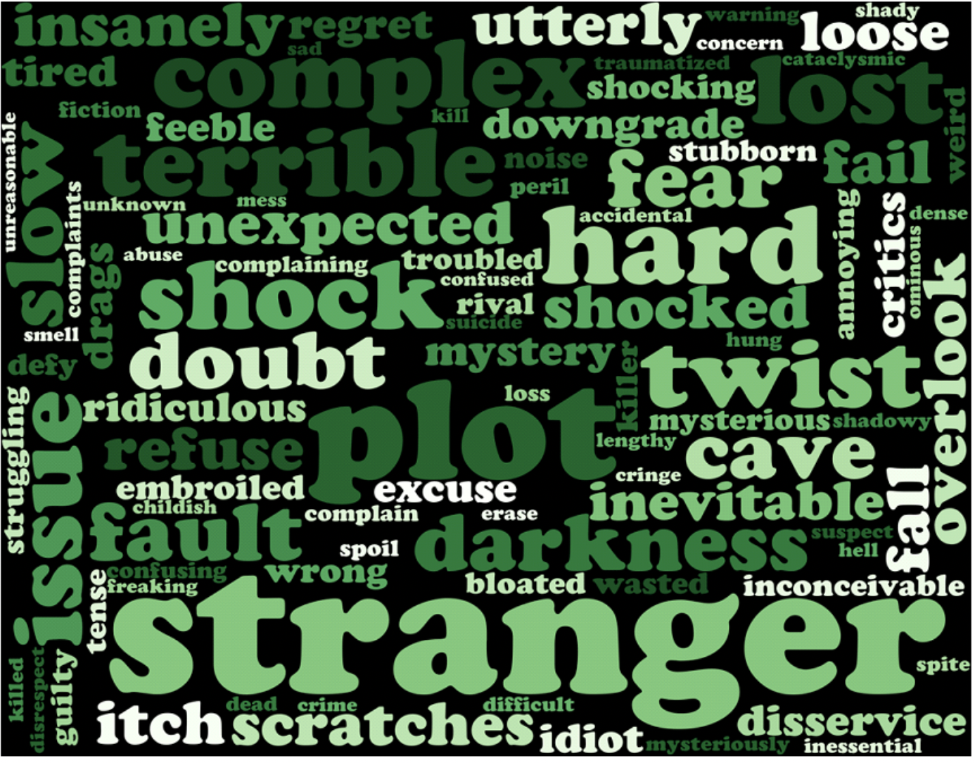
Exploratory data analysis
Negative sentiment analysis on dark

Slide 10
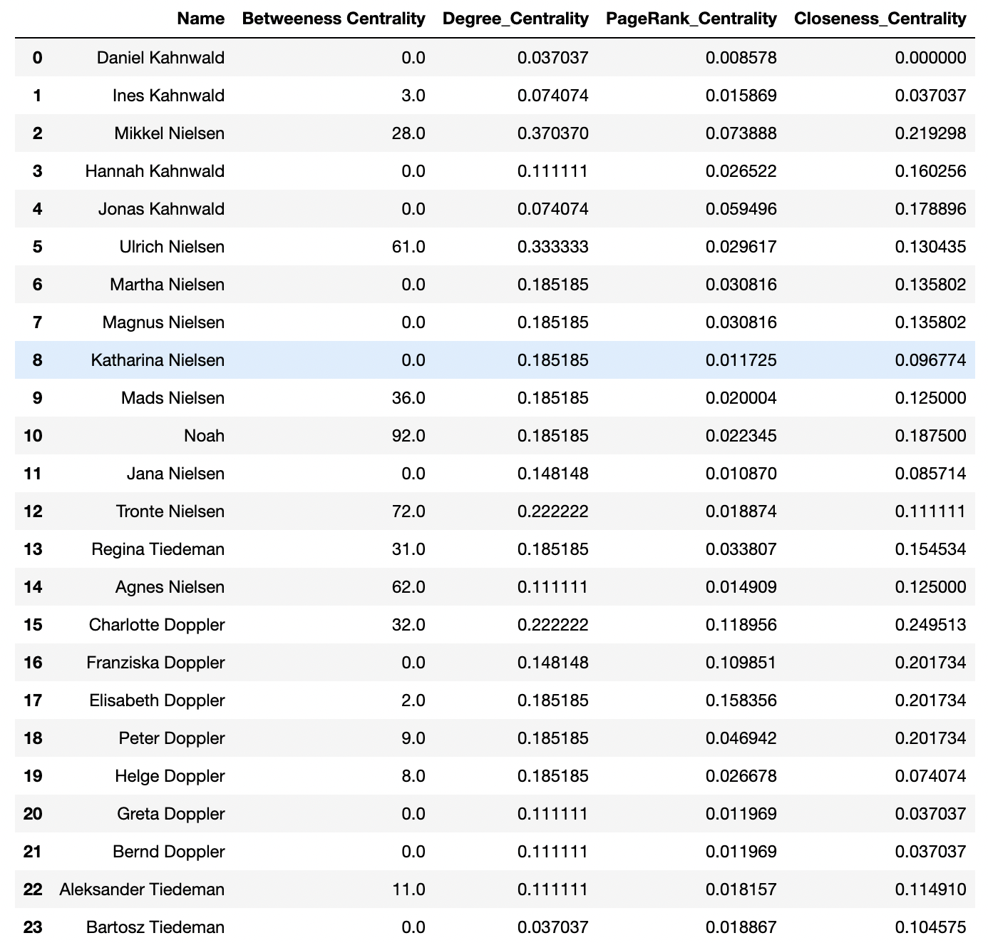
Descriptive statistics
Centrality measures for top 15 characters

Slide 11
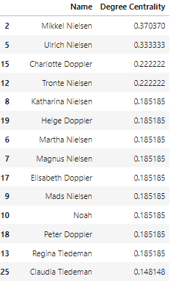
Analytical approach
1)The most important character in dark
First, let's measure the importance of a node in a network by looking at the number of neighbors it has, that is, the number of nodes it is connected to.
Note that there is no "correct" way of calculating the most important node in a network, every metric has a different meaning.
According to degree centrality Mikkel Nielsen is the most important node in the network since it is connected to most nodes
Which makes sense if he didn’t time travel in the first place a huge part of the plot wouldn’t have happened.

Slide 12
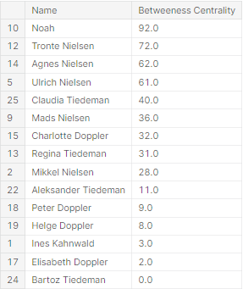
Analytical approach
2) Most influential character in the series
According to the values of betweenness centrality we can see that Noah is the most influential character among all the timelines
Which makes sense because he’s involved in multiple timelines and he’s seen interacting with a lot of characters on the show

Slide 13
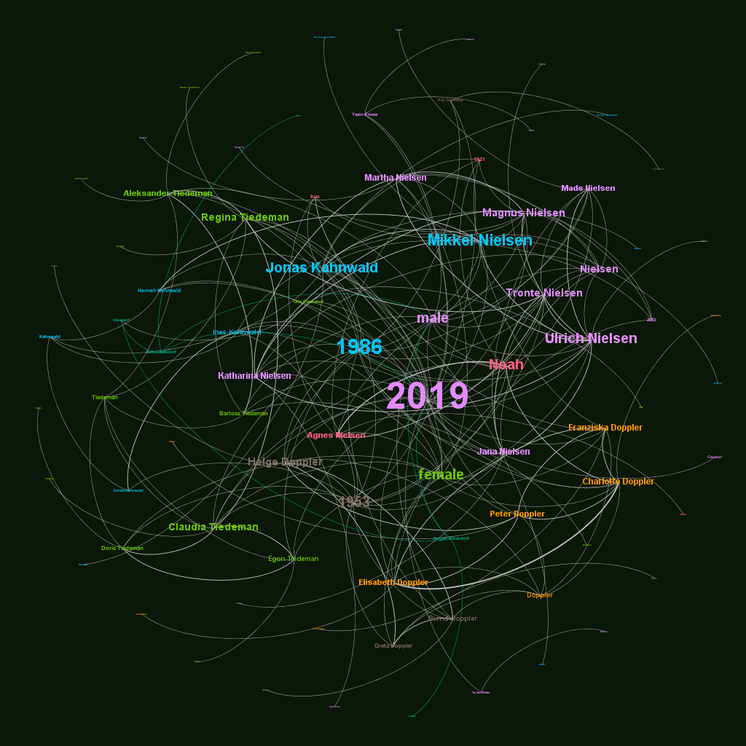
Analytical approach
3) Most important timeline in the series
This graph shows which timeline is more prominent. Out of 4 we can see in the graph 2019 is the most prominent followed by 1986, 1953 and the least prominent is 1921.
Here node size is according to degree
Node color is according to modularity class

Slide 14
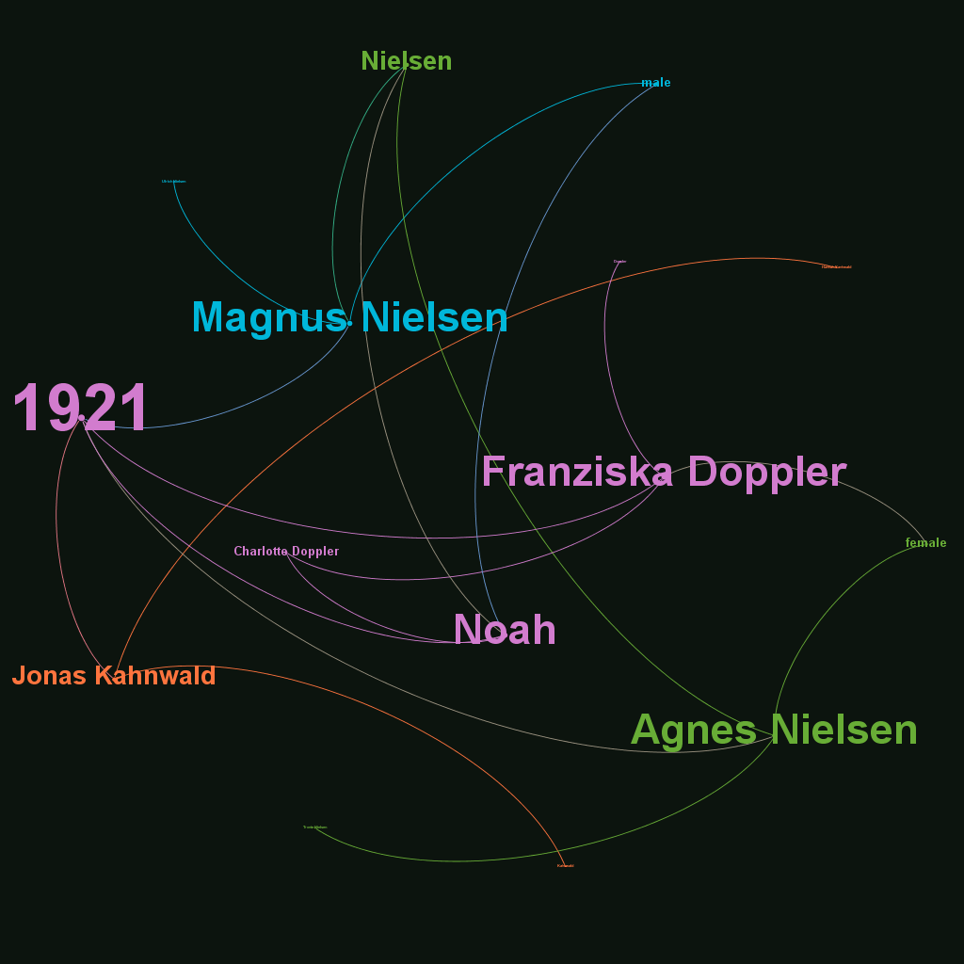
Visualization of characters according to each timeline
We have 4 different timeline 1921, 1953, 1986 and 2019. In this graph we visualize which character are most important in 1921 timeline. Here we can clearly see Magnus Nielsen, Franziska Doppler, Agnes Nielsen, Noah, Jonas Kahnwald are the important character.

Slide 15
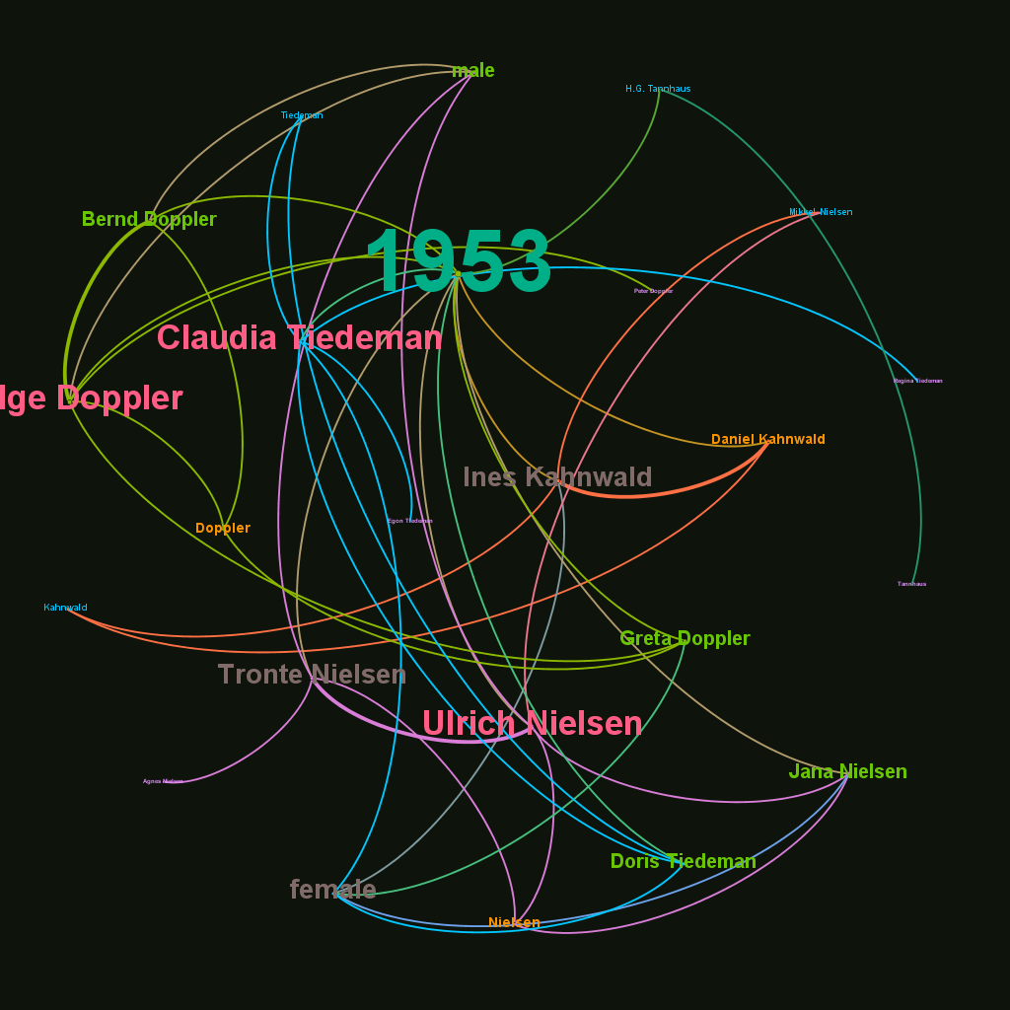
In this timeline there are lot more character than the last one. Here the most influential character are Ulrich Nielsen, Claudia Tiedeman and Helge doppler.

Slide 16
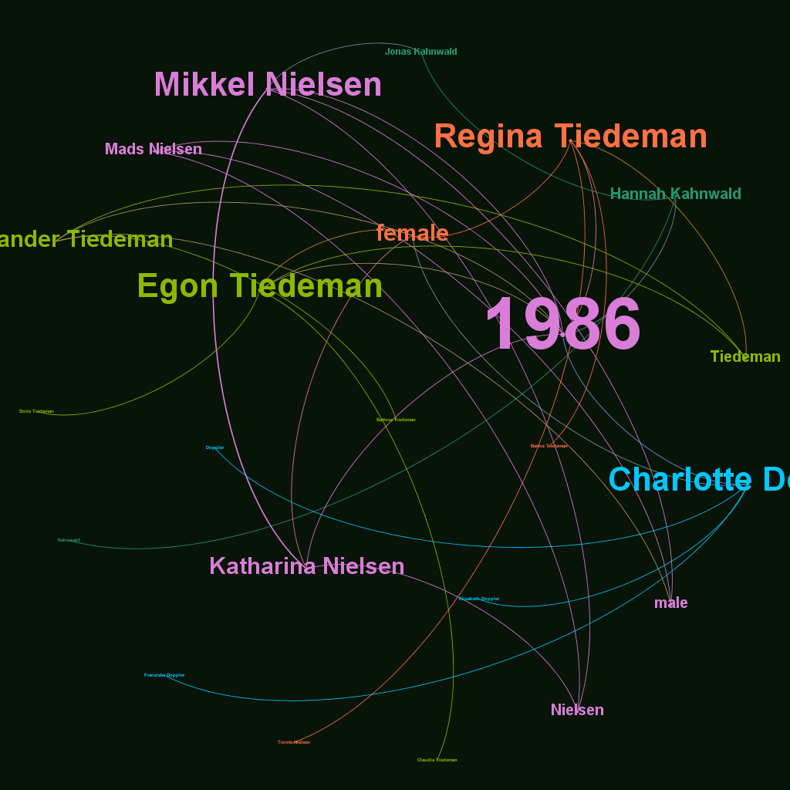
In 1986 the most important character are Mikkel Nielsen, Regina Tiedeman, Egon Tiedeman and charlotte Doppler

Slide 17
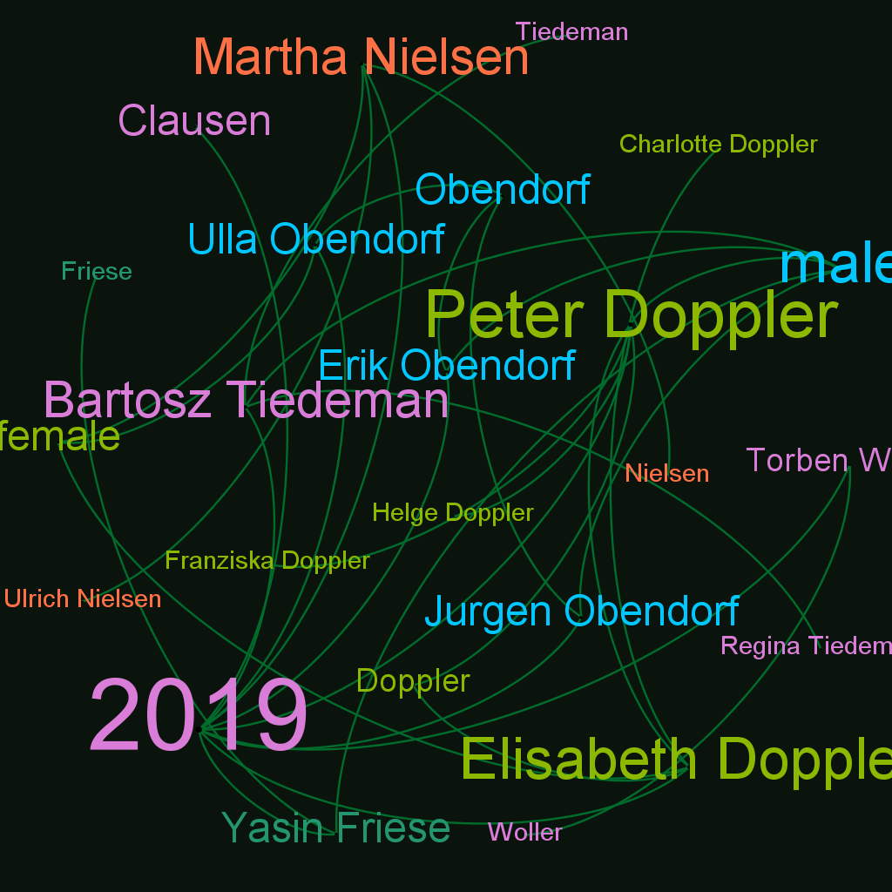
This is the most important timeline among all the 4. In this timeline mostly all the character are present and the most important character are Peter Doppler, Elisabeth Doppler, Martha Nielsen, Bartosz Tiedeman

Slide 18
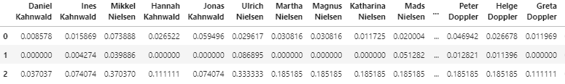
Correlation between different measures
Let's look at the correlation between PageRank, betweenness centrality and degree centrality for the entire show using Pearson correlation.
We see a relatively low correlation between these three measures for our character co-occurrence network.

Slide 19
Interpretations
Using character relationship data of any tv show(like dark) or movie one can specify multiple network centrality measures that can be instrumental in defining the importance of characters in the show.
Overall, a network-based methodology is a fruitful and powerful technique in show/movie analytics: it can serve as a fully-scaled approach or may complement classical statistical instruments.

Slide 20
Recommendations
The producers can make another show based on Mikkel Nielsen maybe a prequel,sequel or a spin off show since he was the most important character on the show.

Slide 21
Thank you

